Slide 1
How to make the Expand My Results be activated by default in a search profile slot
In Primo VE NDE
Yoel Kortick | May 2026

Slide 2
Introduction
The configuration
The new results after changing the configuration
Agenda

Slide 3

Introduction

Slide 4
Introduction
When searching Primo VE without using “Expand My Results” the end user will retrieve only those citations from CDI which are in a resource which has been activated by the library and includes coverage of when the citation was published (and the resource was published to the Central Discovery Index).
When searching Primo VE with using “Expand My Results” the end user will retrieve all citations from CDI regardless of whether or not they are in a resource which has been activated by the library and includes coverage of when the citation was published (and regardless of whether or not the resource was published to the Central Discovery Index).

Slide 5
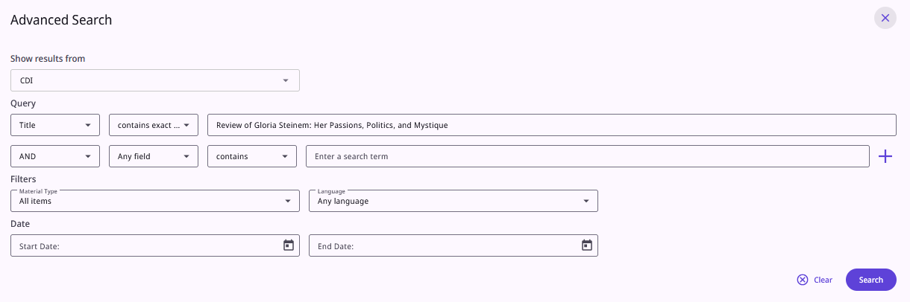
Introduction
For example, here we have searched in a search profile which includes CDI for citation title contains exact phrase “Review of Gloria Steinem: Her Passions, Politics, and Mystique”

Slide 6
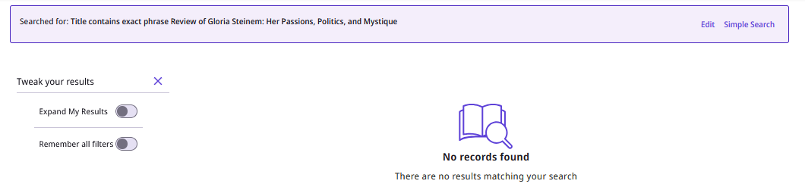
Introduction
We do not check “Expand My Results” and we do not find the citation
“Expand My Results” is not active
By the way the reason these facets appear by default here is because in the view configuration in the “Brief Results” tab we checked the box “Show Filters Panel By Default”

Slide 7
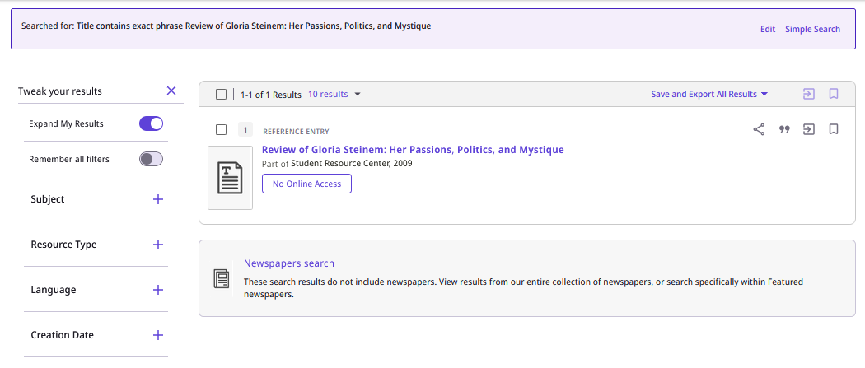
Introduction
We do check “Expand My Results” and we do find the citation
“Expand My Results” is active

Slide 8
Introduction
When “Expand My Results” was not checked we did not find this citation because the library does not have electronic resource “Student Resource Center” for the coverage of the publication of the citation
It states “No Online Access” because even though we retrieved this citation the library does not have access to it.

Slide 9
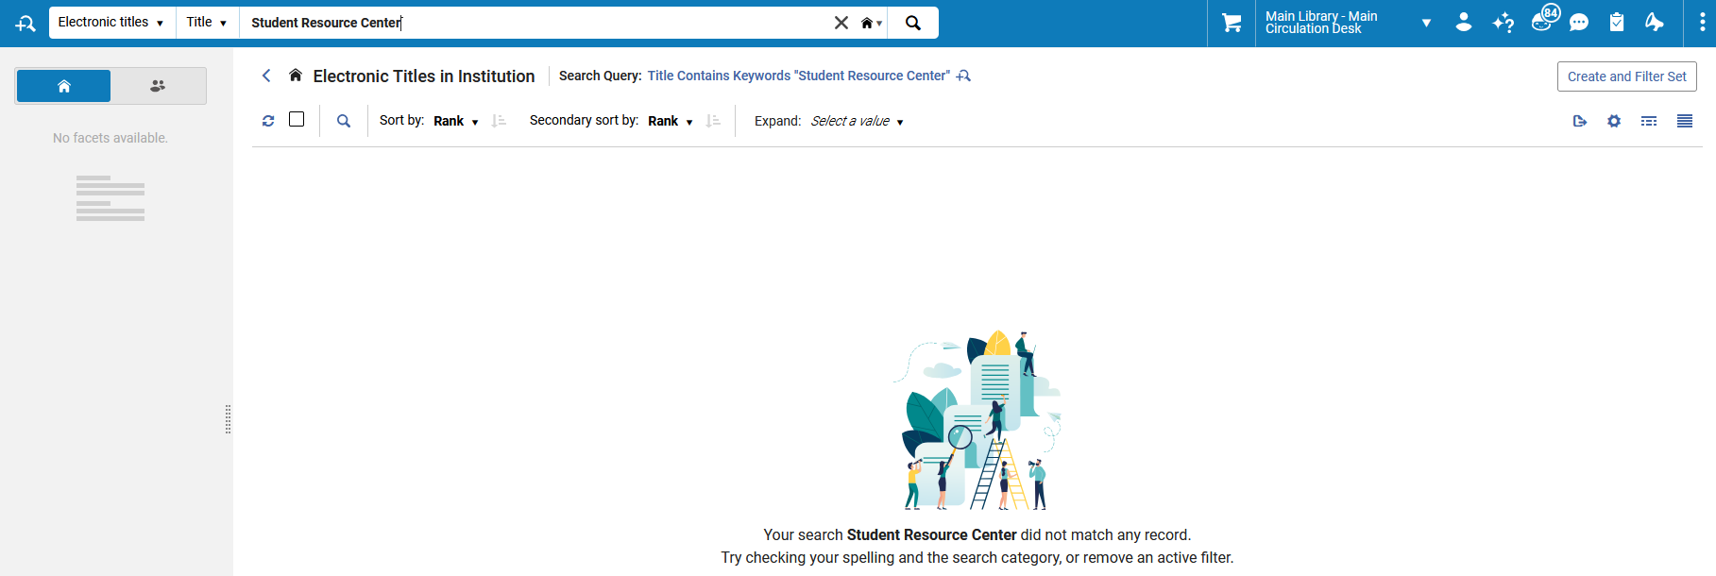
Introduction
The library does not have electronic resource “Student Resource Center” and therefore the citation from this electronic resource was only found when doing “Expand My Results”

Slide 10
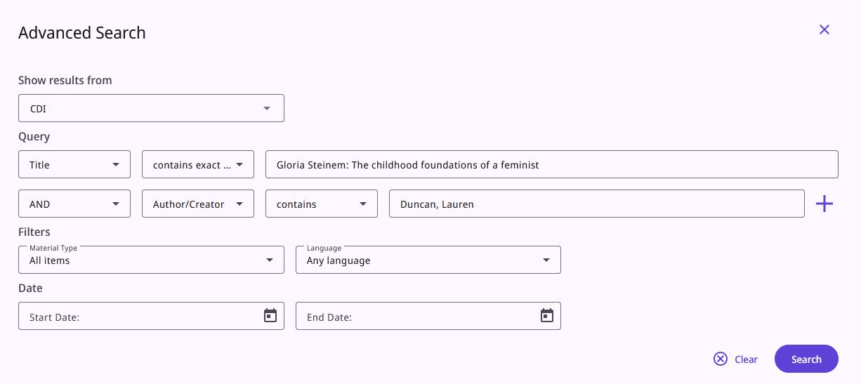
Introduction
If we search for citation “Gloria Steinem: The childhood foundations of a feminist” by author “Duncan, Lauren“ we do find it even without doing “Expand My Results”

Slide 11
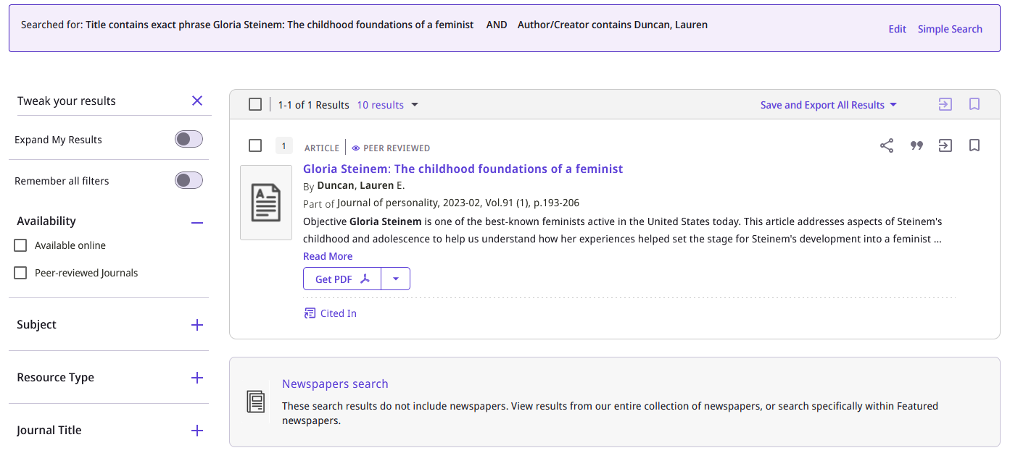
Introduction
“Expand My Results” is not active
We do find the record

Slide 12
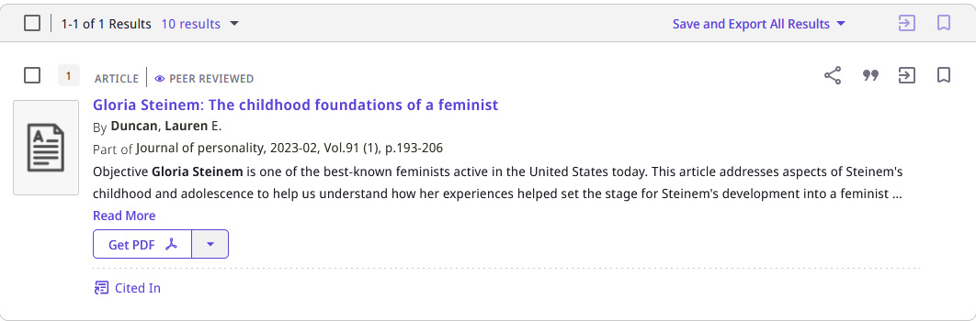
Introduction
This citation was found without “Expand My Results” because the library does have the electronic resource in which it was published with the date for which it was published.
The citation comes from Journal of personality, 2023-02, Vol.91 (1), p.193-206

Slide 13
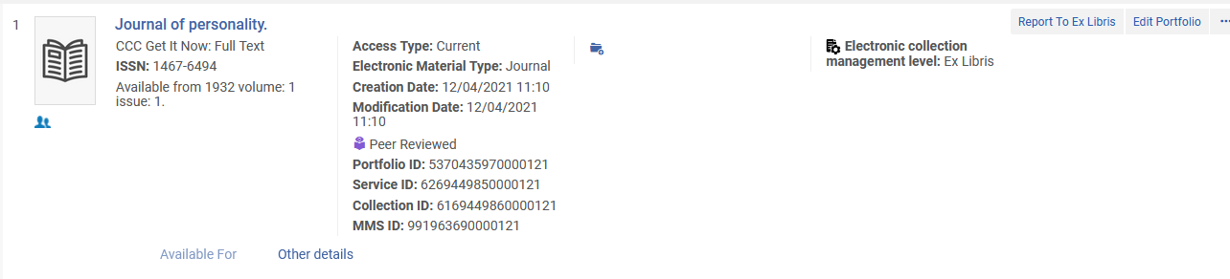
Introduction
This citation was found without “Expand My Results” because the library does have the electronic resource in which it was published with the date for which it was published.
The citation comes from Journal of personality, 2023-02, Vol.91 (1), p.193-206. The library has this resource for this date.
The resource in Alma
The resource in CDI

Slide 14
Introduction
Note that when we search for title contains exact phrase “Review of Gloria Steinem: Her Passions, Politics, and Mystique” and “Expand My Results” is not checked this is the URL:
https://exldeveu00.primo.exlibrisgroup.com/nde/search?query=title,exact,Review%20of%20Gloria%20Steinem:%20Her%20Passions%E2%94%80%20Politics%E2%94%80%20and%20Mystique&tab=CentralIndex&search_scope=CentralIndex&mode=advanced&searchInFulltext=false&vid=EXLDEV1_INST:Alma_NDE&lang=en
Note that when we search for “Happy 90th Birthday, Gloria Steinem” and then from the “no results” clicked “Expand My Results” this is the URL:
https://exldeveu00.primo.exlibrisgroup.com/nde/search?query=title,exact,Review%20of%20Gloria%20Steinem:%20Her%20Passions%E2%94%80%20Politics%E2%94%80%20and%20Mystique&tab=CentralIndex&search_scope=CentralIndex&mode=advanced&searchInFulltext=false&pcAvailability=true&vid=EXLDEV1_INST:Alma_NDE&lang=en

Slide 15
Introduction
We will now see how we can by default make Primo VE behave as if the “Expand My Results” is always checked.
The short description of how this can be done is: Uncheck “Filter By Availability” and clicked “Save” in the relevant search profile.
The full in-depth description is in the following slides.

Slide 16
The configuration

Slide 17
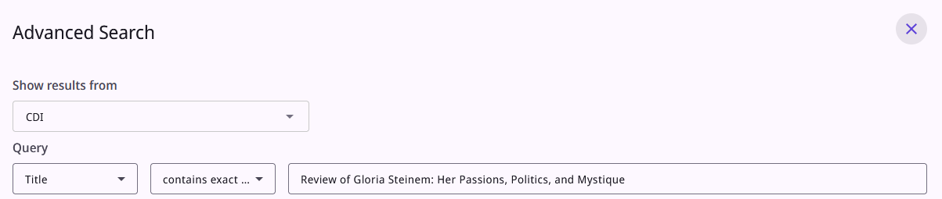
The configuration
We have been searching in view EXLDEV1_INST:Alma_NDE using search profile CentralIndex
https://exldeveu00.primo.exlibrisgroup.com/nde/search?query=title,exact,Review%20of%20Gloria%20Steinem:%20Her%20Passions%E2%94%80%20Politics%E2%94%80%20and%20Mystique&tab=CentralIndex&search_scope=CentralIndex&mode=advanced&searchInFulltext=false&vid=EXLDEV1_INST:Alma_NDE&lang=en

Slide 18
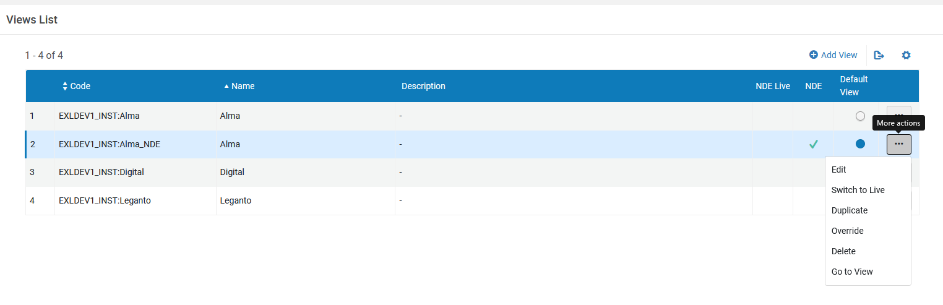
The configuration
We will access the views at “Discovery > Display Configuration > Configure Views” and edit the view EXLDEV1_INST:Alma_NDE

Slide 19
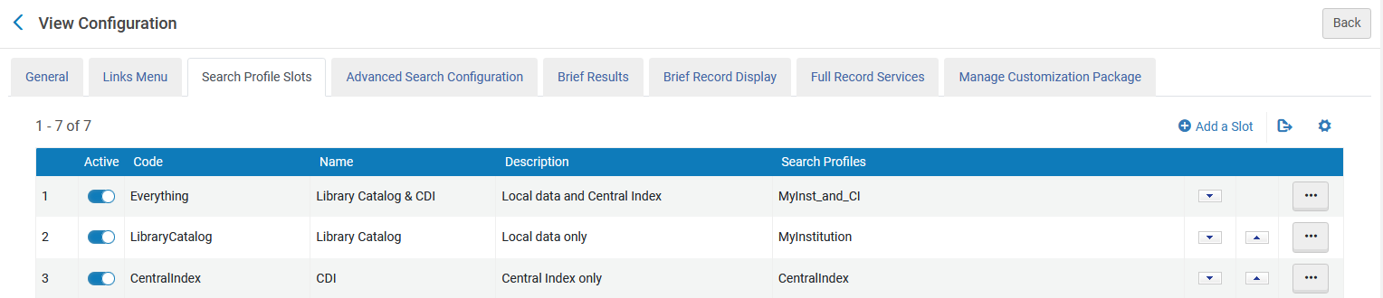
The configuration
In the “Search Profile Slots” tab we see that “CDI” (code “CentralIndex”) includes search profile “CentralIndex”

Slide 20
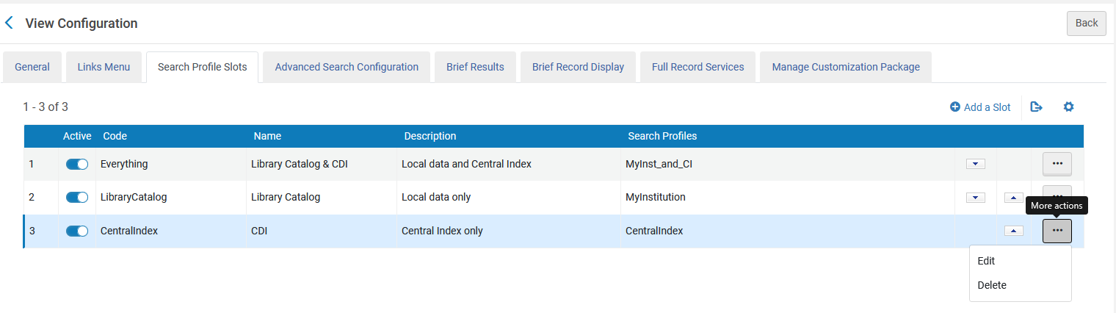
The configuration
We will edit the Search Profile Slot

Slide 21
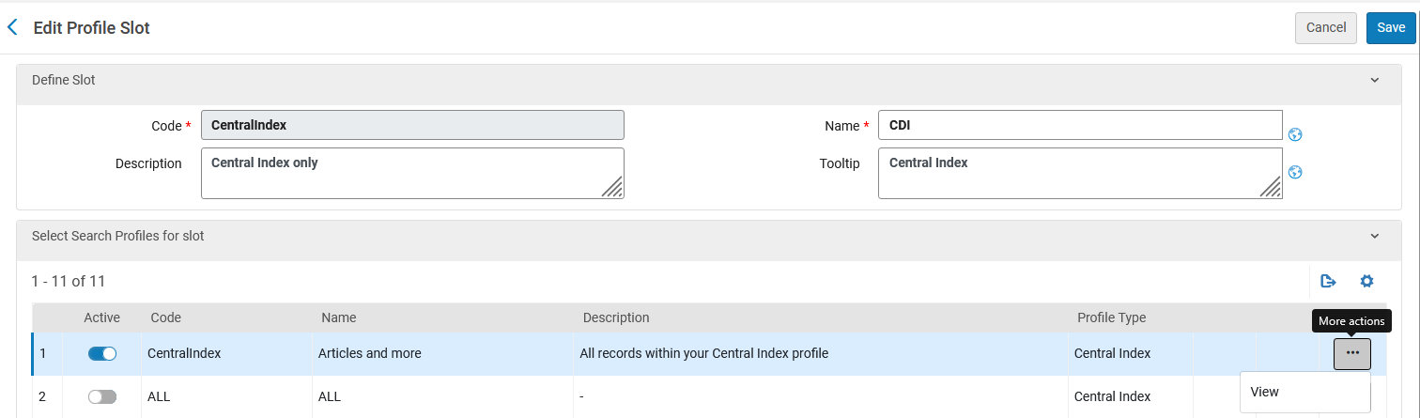
The configuration
Now we will view “CentralIndex”

Slide 22
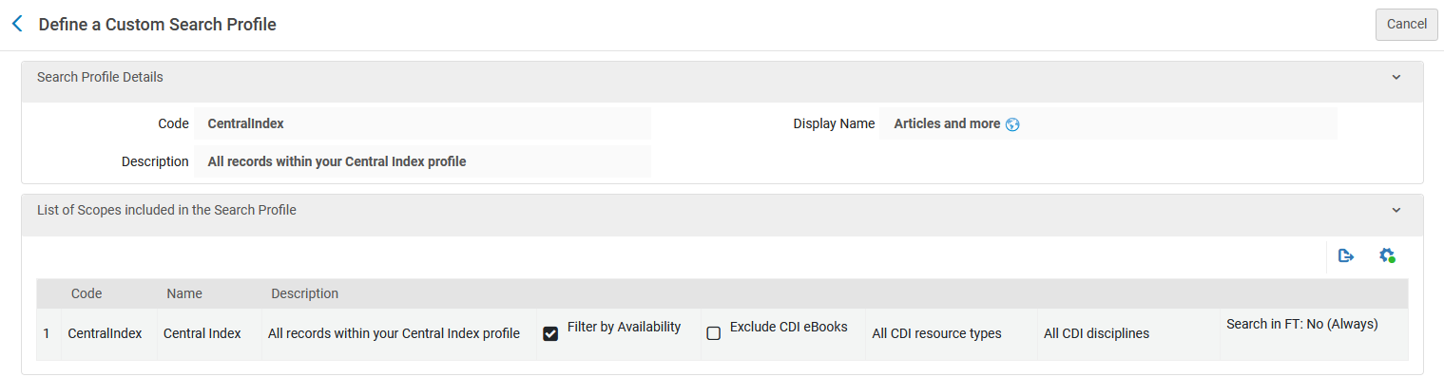
The configuration
We see that search profile code “CentralIndex” display name “Articles and more” includes scope code “CentralIndex” name “Central Index”
Filter by availability is checked. This means “Expand my results” will by default be unchecked (which means it filters only by resources available to the institution).
This cannot be checked and unchecked from here. It needs to be edited at “Discovery > Search Configuration > Search Profiles”

Slide 23
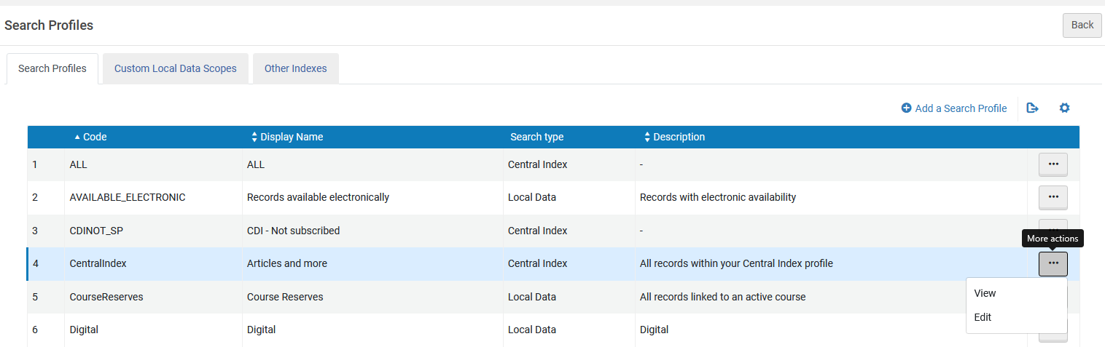
The configuration
Now that we know that search profile code “CentralIndex” display name “Articles and more” includes scope code “CentralIndex” name “Central Index” we will edit the search profile code “CentralIndex” display name “Articles and more” to have “Expand My results” be the default.
This can be done at “Discovery > Search Configuration > Search Profiles”

Slide 24
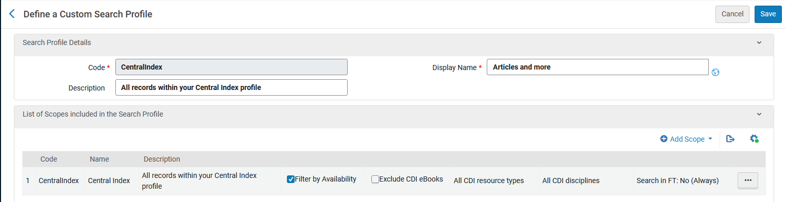
The configuration
We see the “Filter By Availability” is checked for “Central Index”.
This means that by default “Expand My Results” will not be checked.
This is the current setup.

Slide 25
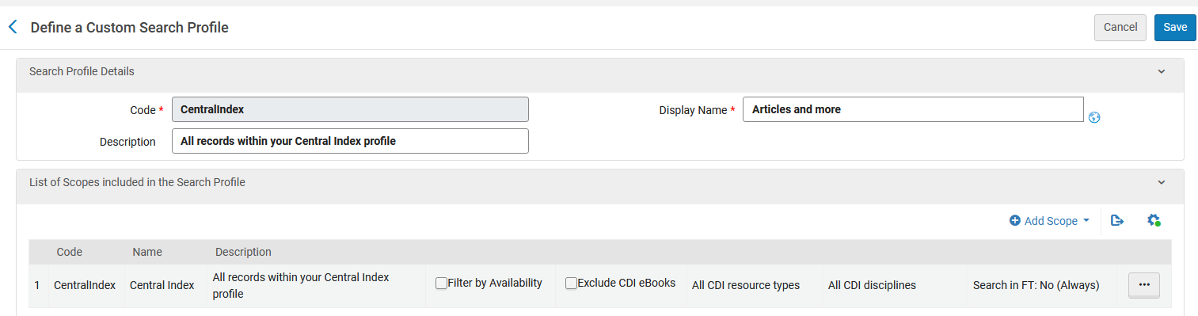
The configuration
We have now unchecked “Filter By Availability” and clicked “Save”.
Therefore “Expand My Results” will be checked by default in the Primo VE search profile

Slide 26
The new results after changing the configuration

Slide 27
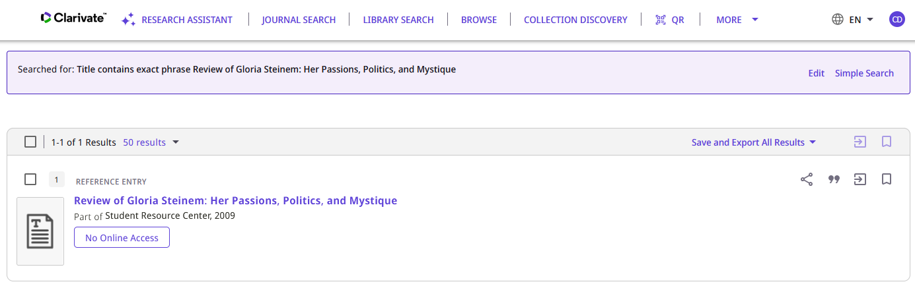
The new results after changing the configuration
Now if we again search in the search profile CDI for citation title contains exact phrase “Review of Gloria Steinem: Her Passions, Politics, and Mystique” we do find the citation in CDI (because by default “Expand My Results” is checked and we do not see the option on the screen). Previously we found this citation only after manually activating “Expand My results” on the search results screen.
There is no “Expand My Results” option. Primo is behaving as if it is there and checked.

Slide 28
Thank You

